Slide 1

Securing Your Finances: A Deep Dive into Online Banking Cryptography
Clear, concise walkthrough of how banks protect transactions and accounts using modern cryptography, authentication, and layered defenses. Focus: confidentiality, integrity, authenticity, and practical steps you can take.

Slide 2


The Digital Vault: How Online Banking Stays Safe
Layered Security
Core Goals
Multiple controls work together — cryptography, authentication, monitoring, and policies.
Confidentiality, integrity, availability, and non-repudiation.
Real-time Monitoring
Fraud detection systems flag anomalous behavior before funds move.
Theme accents use #eee27dff and #F4E883 to highlight key concepts.

Slide 3

AES Encryption: The Foundation of Data Confidentiality
What it is: AES (Advanced Encryption Standard) is a symmetric block cipher used to encrypt data at rest and in transit inside banking systems.
Common strengths: 128-, 192-, 256-bit keys (AES-256 typical for high-security).
Use cases: database encryption, TLS session payloads, secure backups.
Performance: fast on modern hardware — ideal for high-volume banking traffic.
Result: Even if data is intercepted, AES renders the payload unreadable without the key.

Slide 4
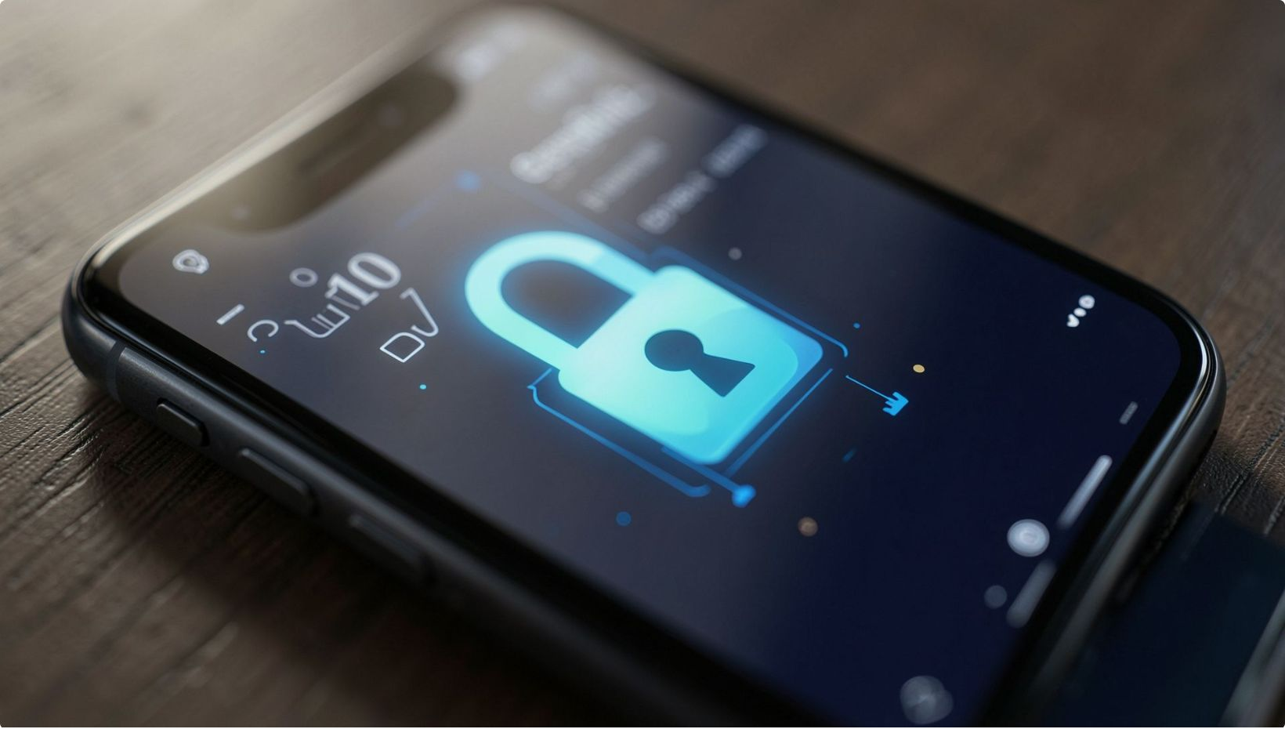
RSA Key Exchange: Establishing Secure Communication Channels
Purpose: RSA (asymmetric cryptography) enables secure key exchange and identity verification using public/private keypairs.
Server presents a public key (certificate) — client verifies via PKI.
Client encrypts a session key with the server's public key; only server can decrypt with its private key.
Commonly used in TLS handshakes to bootstrap symmetric AES sessions.
Security notes: Strong RSA key lengths (2048–4096 bits) and certificate validation prevent man-in-the-middle attacks when implemented correctly.

Slide 5

Digital Signatures: Ensuring Authenticity and Non-Repudiation
What they do
Use cases
Non-repudiation
Bind a sender to a message using the sender's private key; recipients verify with the public key.
Transaction approvals, contract signing, secure API requests.
Provides cryptographic proof that a specific party authorized an action.
Common algorithms: RSA signatures, ECDSA (Elliptic Curve) for smaller keys and faster verification.

Slide 6

Two-Factor Authentication (OTP): Your Extra Layer of Protection
Second factor types:
Time-based OTP apps (TOTP) — authenticator apps like Google Authenticator.
SMS OTP — convenient but vulnerable to SIM swap; considered weaker.
Hardware tokens & push notifications — higher security and phishing resistance.
Best practice: Prefer authenticator apps or hardware tokens; combine with device fingerprinting and session risk analysis.

Slide 7
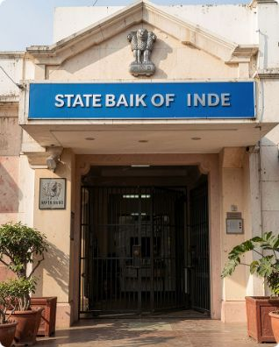

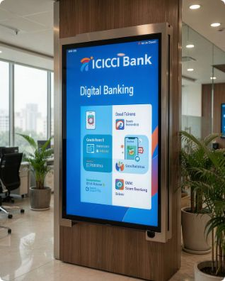
Real-World Security: Cryptography in Action at SBI, HDFC, and ICICI
SBI
HDFC
ICICI
Enterprise TLS with strong ciphers, multi-layer authentication, and transaction signing for high-value transfers.
Uses device binding, app-level encryption, tokenization of payment data, and risk-based 2FA flows.
Implements strong PKI, end-to-end encryption in mobile apps, and behavioral analytics to detect fraud.
These banks combine cryptography with operational controls (monitoring, fraud teams, regulatory compliance) to protect customers.

Slide 8


Live Demonstration: Encrypting a Transaction, Step-by-Step
Create & Encrypt
Encrypt AES Key
Bank Decrypts
Caption: This sequence shows how symmetric encryption (AES) protects the bulk payload while asymmetric RSA secures the session key — combining speed with secure key exchange.

Slide 9


Beyond the Basics: Emerging Threats and the Future of Online Banking Security
Threats
Trends
Phishing, SIM-swap, supply chain compromises, and advanced persistent threats targeting credentials and servers.
Post-quantum cryptography planning, wider adoption of ECDSA/ECDH, hardware-backed keys, and biometric multi-factor flows.
Resilience
Zero-trust architectures, continuous authentication, and automated anomaly response will raise the bar for attackers.
Banks are already planning migrations to quantum-resistant algorithms — long-term protection matters.

Slide 10
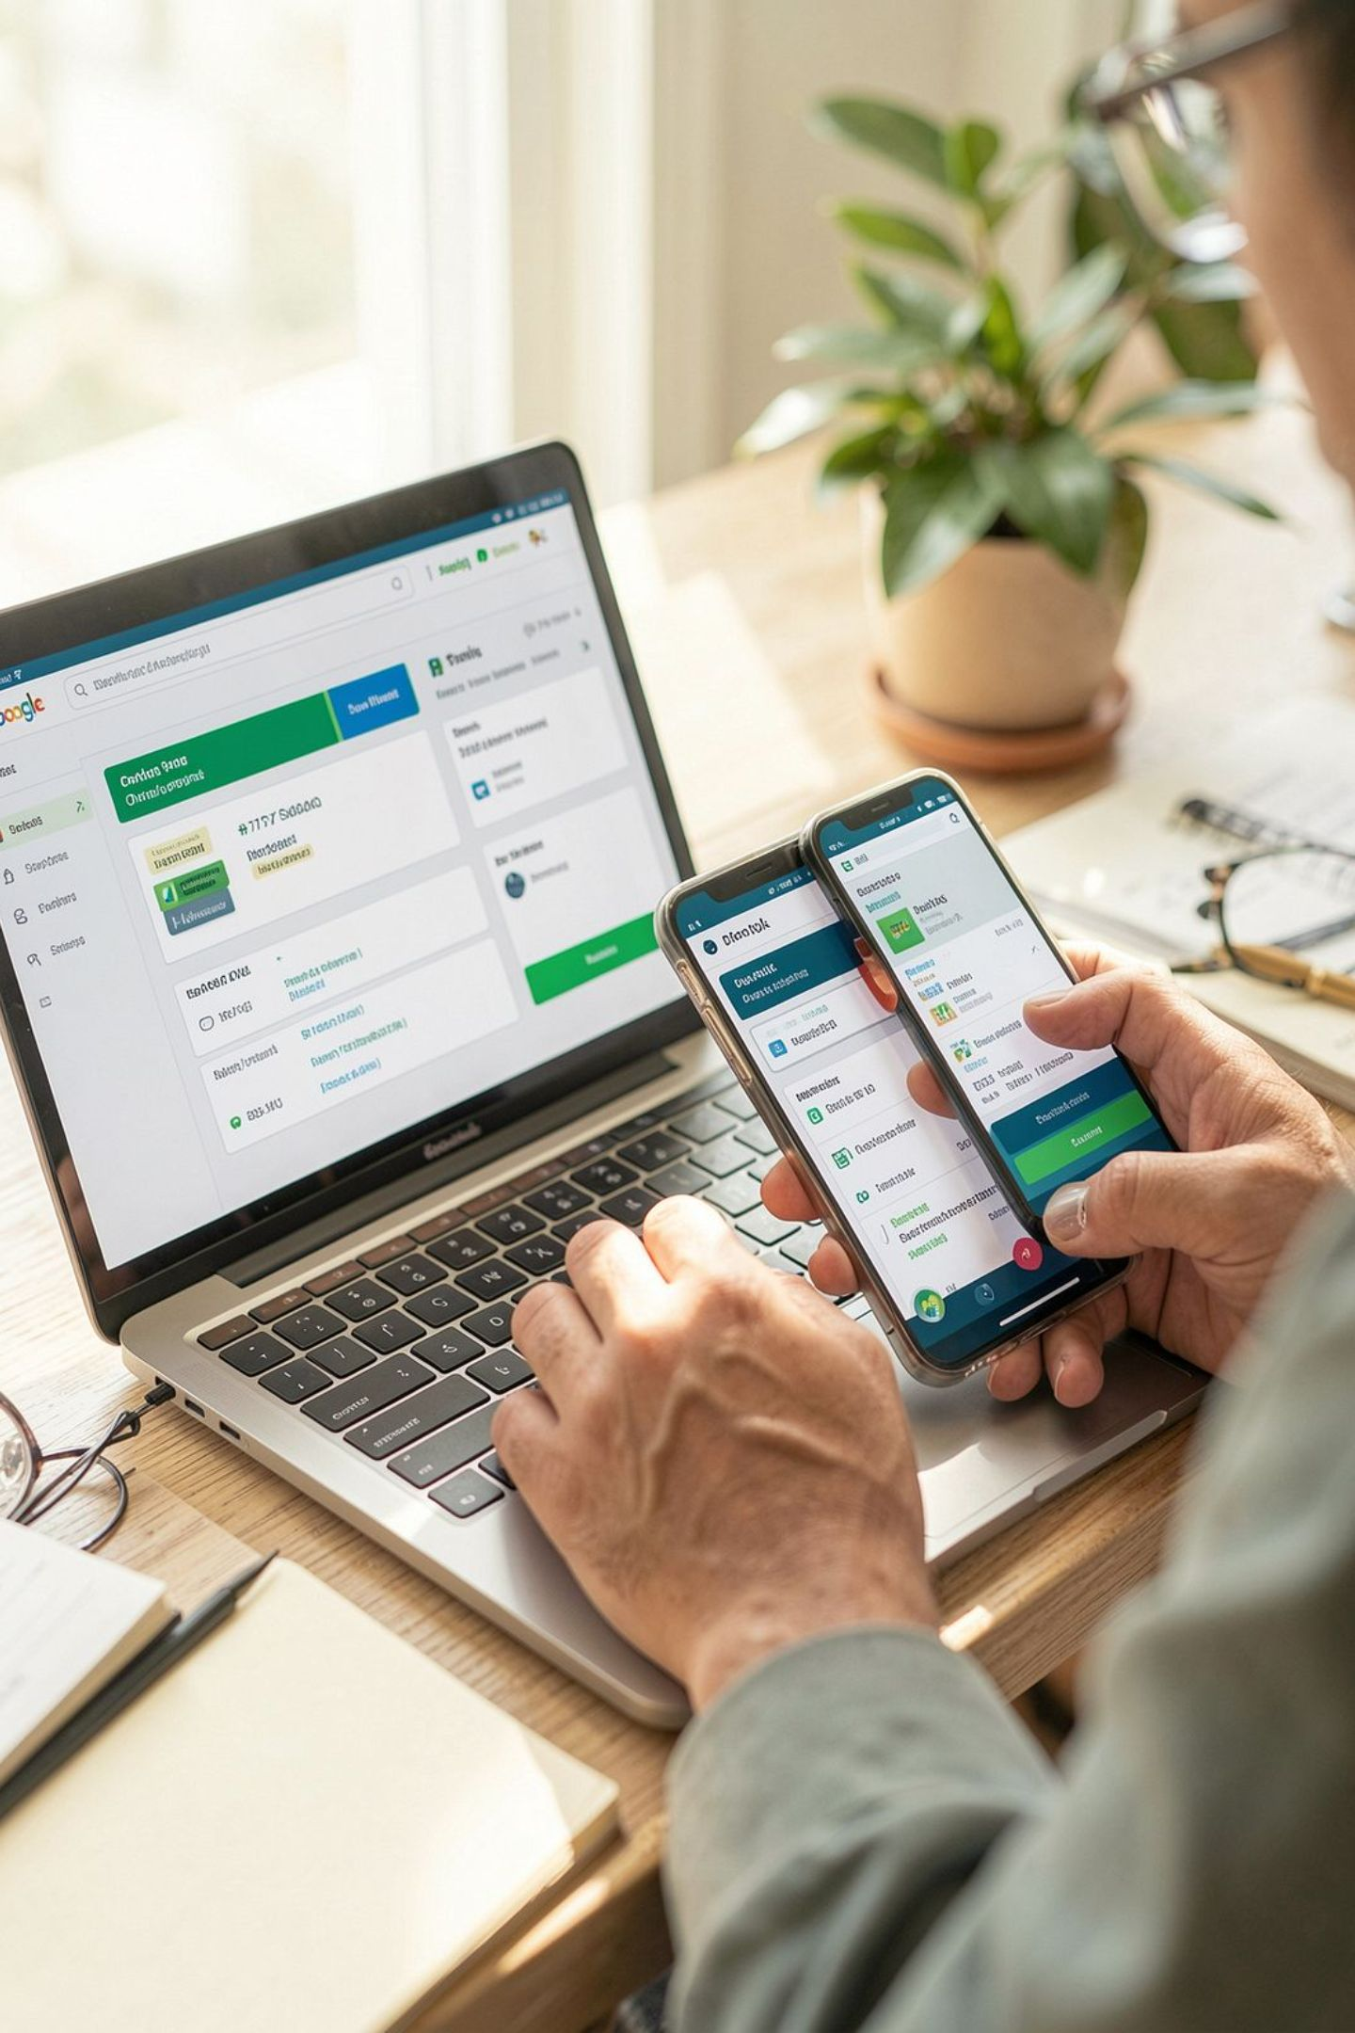

Your Role in Security: Best Practices and Key Takeaways
Protect credentials
Final checklist
Use unique passwords and a password manager.
Look for TLS padlock and valid certificate when banking online.
Keep apps & OS updated to maintain cryptographic library security.
Report suspicious activity immediately to your bank.
Enable strong 2FA
Prefer TOTP or hardware tokens over SMS.
With AES + RSA + digital signatures + strong 2FA, online banking is secure when best practices are followed by both banks and customers.
Verify before you act
Always confirm unexpected transfer requests with the bank directly.

Slide 11


